Slide 1
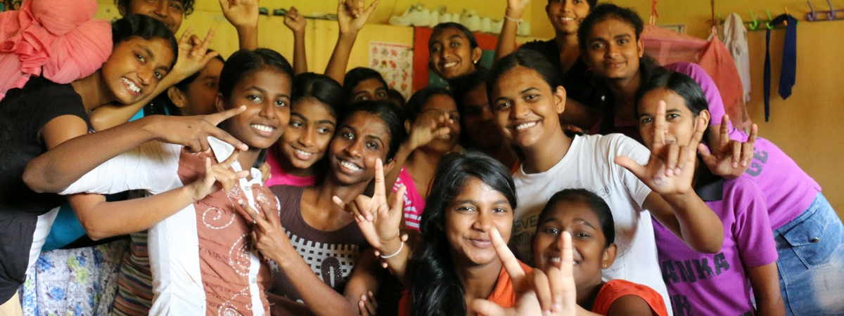
Adolescent Health
Dr. Lathika Athauda

Slide 2
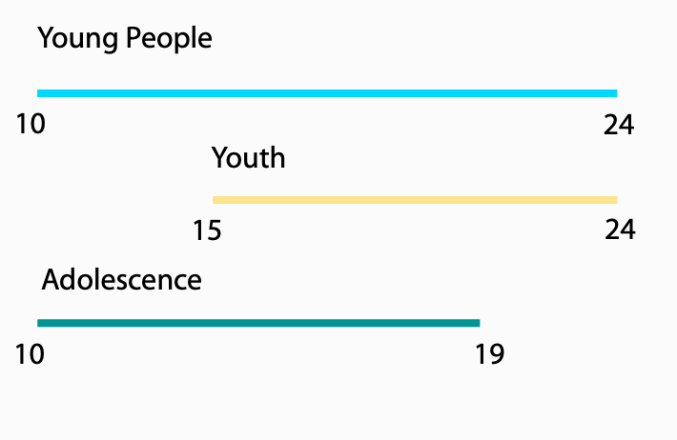
Who are adolescents?
Notes:
1 in 6 people are adolescents
South asia has the largest proportion of world adolescents

Slide 3

Who are Adolescents?
Persons aged 10 – 19 years
School going
Out – of – school (workforce, community, education institutions)
1/4th of the the population – South Asian adolescents (2016)
Adolescent health influenced by social and structural determinants

Slide 4
Stages of adolescence
Early adolescence ( 10 to 14 years )
Mid adolescence (15 to 17 years )
Late adolescence (19 to 19 years)
Teenager ( 13 to 19 years)

Slide 5
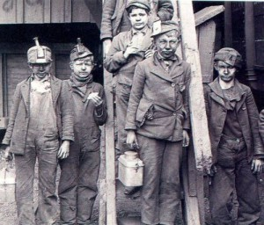
Adolescents in 19th century
Historically considered small humans
Shift of thinking in early 1900s
Industrial revolution

Slide 6
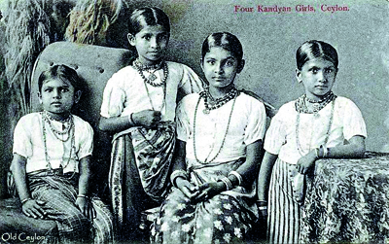
Evolution of adolescence
Then
Chimney sweeps and coal minors at 10 years
Married with children at 14 years
Now
School education until end of adolescence
Age of marriage shifting to 20s

Slide 7
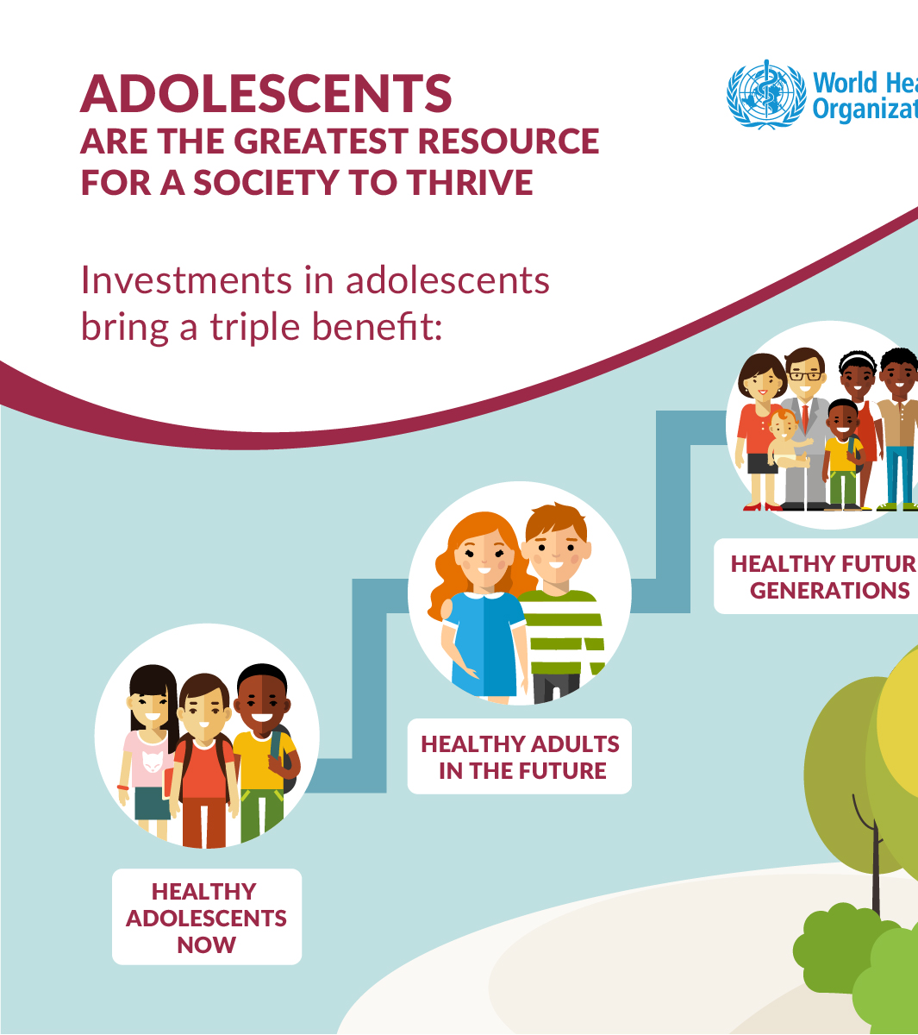
Why are adolescents important
Adolescents are particularly vulnerable to certain health issues
Critical behaviours shaped during adolescence
Maximum physical, psychological and behavioural changes
Affect health in the future.
Triple effect of adolescence (now, future and next generation)

Slide 8


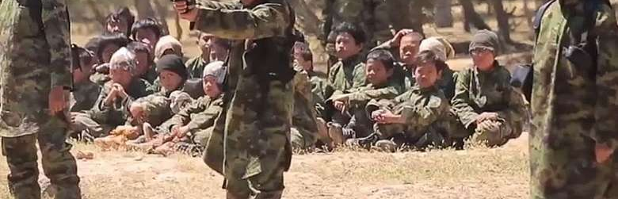

Adolescents of the 21 century
Terrorism as a domestic issue
Fully compete in a global economy
Experience instantaneous communication globally
Grow up in single parent households
Experience gender identity issues / sexuality issues
Facing climate change and problems in eco systems

Slide 9
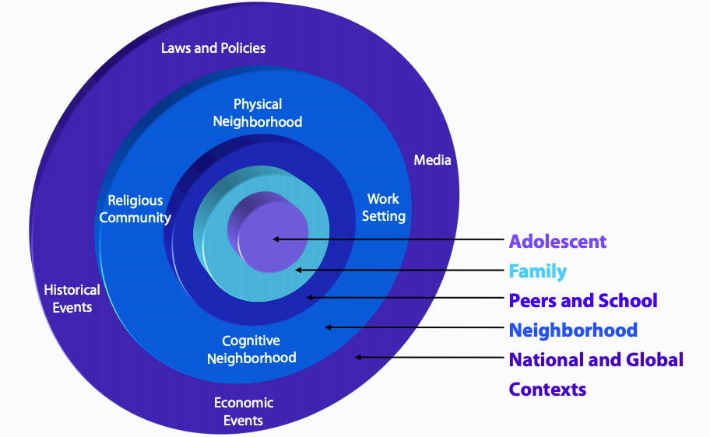
Shifting of frameworks
Risk model framework for youth programs
Positive youth development model – protective and rist factors
Adolescent central progamms

Slide 10
Global adolescent health problems
Over 1.1 million adolescents in 2016 died due to preventable causes
Road traffic accidents was the leading cause of death I 0216
Mental health disorders in adoluthood start at 14 years – undetected
44 births per 1000 girls between age of 15 to 19
Substance use - (1 in 10 13 to 15 year olds use tobacco)
Obesity and lack of physical activity

Slide 11
Risk Faced by adolescents
Violence / Road traffic injuries
Drug & Alcohol use
Risky sexual behaviours
Mental health problems
Unhealthy lifestyle
Pregnancy and sexually transmitted disease
Suicide / self harm / substance use
Obesity / NCD risk
Notes:
Mental health problems – stress/ gender identity. Sexuality, family problems

Slide 12

Risk taking behaviours
Substance use (alcohol, drugs )
Sexual exploration
Limitations in decision making
Limitations in managing emotions
Normalzation of taking risks
Poverty and exposure to violence

Slide 13

Normal structure and function
Lymbic system and amygdala (important for emotions and rewards) are developed early
Frontal lobe (important for reasoning, decision making, self discipline) are fully mature by youth
Adolescents are naturally prone to take risks

Slide 14

Why do adolescents behave the way they do?
Two key areas of the brain mature at different times
Shift from utopia to reality
Future time perspective
When future options look grim – make poor decisions
Shift from ego centrism to mutuality

Slide 15
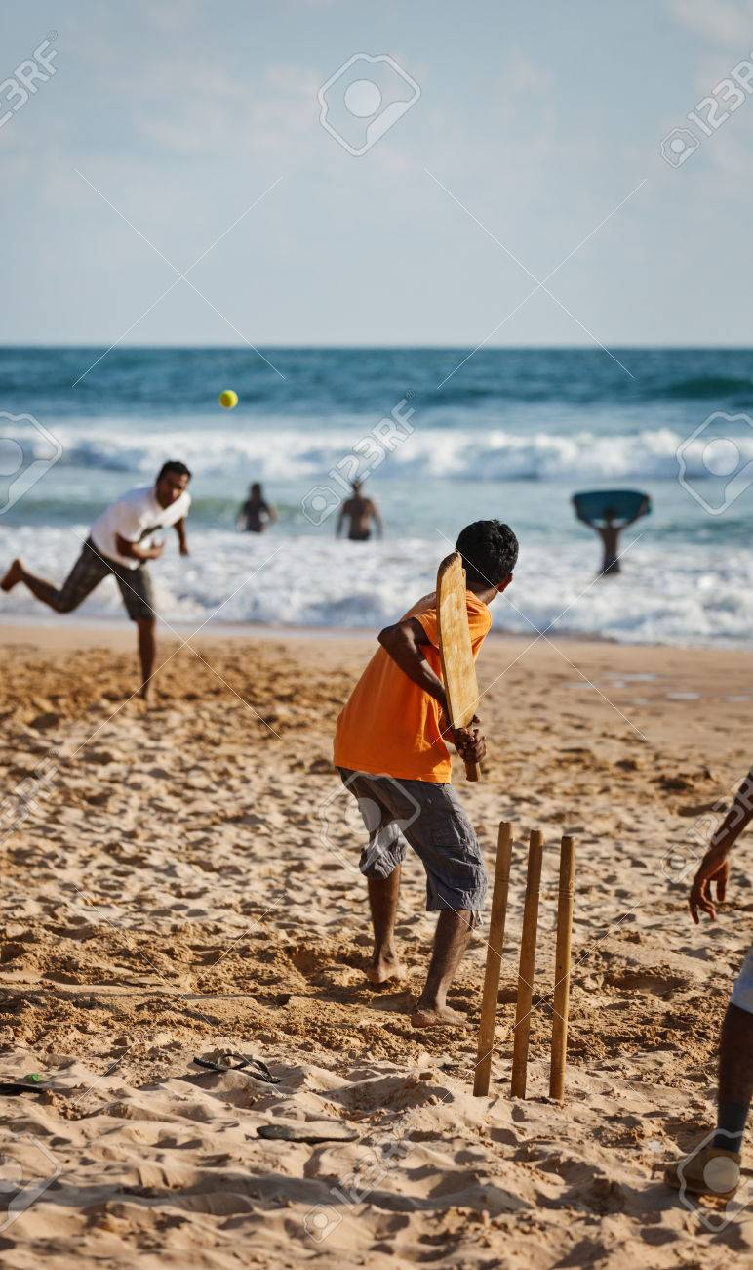
Adolescent Development in a Social Context
Adolescent development is heavily determined by contexts within which the young person lives
Dependent on the environment
Environment positively or adversely affect development
Individual is shaped by the environment and environment is influenced by the individual
Reciprocal effect
Language, culture, family, peers, social environment makes a big impact
Notes:
The same environment can be either protective or risk enhancing – Kawai study – military
Relationships – test images of ourselves, explore different roles that develop in to adults

Slide 16
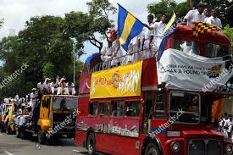
Adolescent within the community
Adolescents are not problems to be solved
They are resources to be developed
Healthy development –a community affair
The environment in which they are nurtured will determine their outcome
Notes:
Their

Slide 17
adolescents and their drinking
Prevalence of heavy episodic drinking among 15 – 19 year old's – 16% globally (in 2012)
Males at more risk
6% of all global deaths due to alcohol
Alcohol is the leading cause of DALYs among15 – 19 year olds

Slide 18
Adolescents and Tobacco Use
Search Sport survey ADIC 2017

Slide 19
Other main health issues
Injuries – leading cause of death and disability
Mental health problems
Violence (one in 3 adolescent girls have faced violence)
HIV/AIDS (2.1 million adolescents living with HIV in Africa alone)
Other infections diseases
Early pregnancy and child birth
Nutrition and micronutrient deficiencies
Under nutrition and obesity (adolescents need 60 mins of physical activity daily)

Slide 20
Governmental Institutions
School and Adolescent Health Unit (Family Health Bureau)
Medical Officers of Health
Directorate of Youth, Elderly and Disabled (Ministry of Health)
Youth Friendly Health Centers

Slide 21
Services
School Medical Inspections
School Dental Health programs
Immunization program
Youth Friendly Health Services
Skill building programs for out of school adolescents
Life Skills programs and schools

Slide 22
Non Governmental organizations
Savrodaya
Family Planning association
Red Cross
Plan Sri Lanka
Sewa Lanka
Child Fund
Sumithrayo
Alcohol and Drug Information centre

Slide 23
Ethics and adolescent health
Confidentiality
Sensitivity to their health issues
Communicating to adolescents
Legal frameworks to protect adolescents (Child Rights Convention)
Rights of adolescents

Slide 24
Adolescent Health Seminar
Lecture – 01/ 07/ 2019
Integrated Teaching Seminar – 05/ 07/ 2019

Slide 25
